Slide 1

Distributed Systems CS6421 Intro to Distributed Systems and the Cloud Computing
Prof. Roozbeh Haghnazar
Slides Credit:
Prof. Tim Wood and Prof. Roozbeh Haghnazar

Slide 2
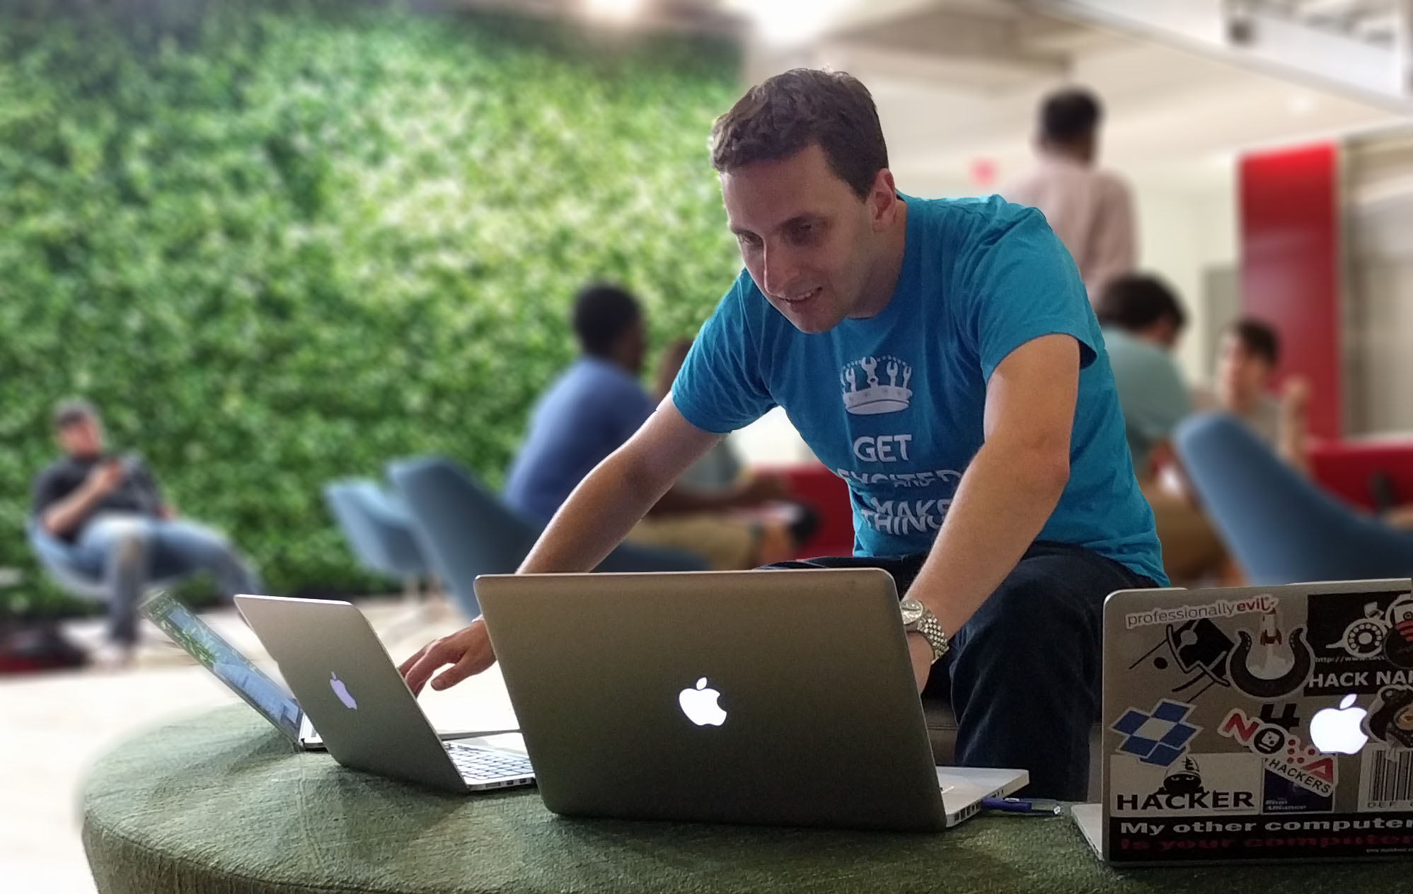
Prof. Tim Wood
Research: Virtualization platform design, cloud resource management, and software-based networking
Teaching: Distributed Systems, Networking, Software Engineering, Senior Design

Slide 3
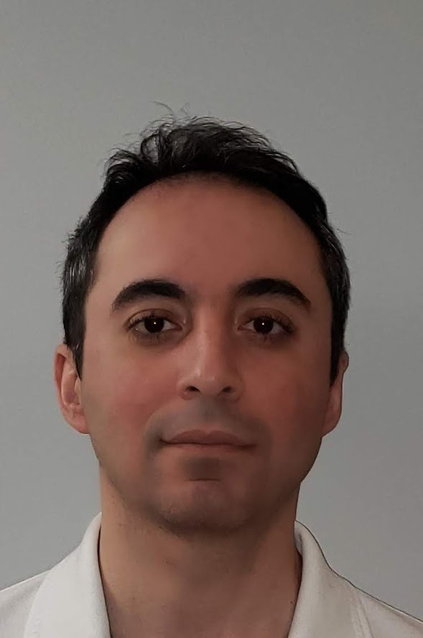
Prof. Roozbeh Haghnazar
Started Programming in1991 with Commodore 64
Played several roles in technology, such as Developer, Modeler, Designer, Architect, Leader, CTO, etc.
Teach Software Eng., Distributed Systems, Data Base Design Principles, Data Visualization, Operating System.

Slide 4
About This Course
Be prepared! (course prerequisites)
CSCI 6212 Algorithms (or undergrad algorithms course)
An undergraduate operating systems course
Be involved!
“Raise hand”, ask questions , discuss, etc.
Asynchronous opportunities will be available
Be ready to code!
You will need to use Go, Python for your assignments
Mostly group projects

Slide 5
Classes
2.5 hours is a long time for lectures!
We will try to break it up – discussions, demos, live coding
Some lectures may end early, with additional asynchronous material
We want to make the best course we can for you!

Slide 6
Participate!
You must “participate” 2X per week:
Attend lecture or office hours
Post a question/comment/answer on BB/Slack (during or outside of class)
Examples:
Attend both lecture and office hours = 2 points ☺
Attend office hours and ask a question = 2 points ☺
Post 3 questions = 2 points ☺
Only attend lecture = 1 point ☹

Slide 7
Resources
Slack: (linked from website, join after class)
GitHub for collecting assignments
Blackboard for grades, class meetings, and office hours
Visual Studio Code – recommended IDE
Live share plugin allows group collaboration / help in office hours
Repl.it – simple online editor for quick programming exercises
You can login with GitHub credentials if you want to save copies

Slide 8
Semester Outline
Building Blocks
Introduction to Distributed System and Cloud
Scalable Execution: Processes, threads, VMs, containers, parallelism vs concurrency
Communication: RPC, Message Oriented, Stream Oriented
Principles of Distributed Systems
Coordination: Synchronization, Consistency, and Consensus
Reliability: Replication and Fault Tolerance
Performance: Metrics and Modeling Large Scale Systems
Distributed Systems in Practice
Grid Computing
Cloud Computing
Web, Mobile, and IoT
4 Go programming assignments
Midterm
Large group project

Slide 9

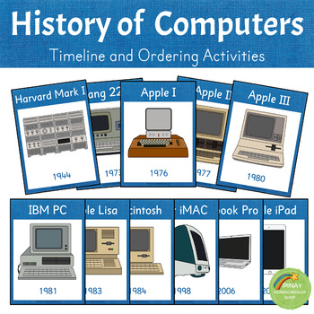
Introduction
Computer systems are undergoing revolution.
Two advances in technology changed the game
8bit -> 16bit -> 32bit -> 64bit microprocessors
From a machine that cost $10M and executed 1 inst./sec we have come to machine that cost $1000 and execute 1 billion inst./sec
Computer networks LAN/WAN
From 64 Kbit/sec to Gigabit/Sec

Slide 10

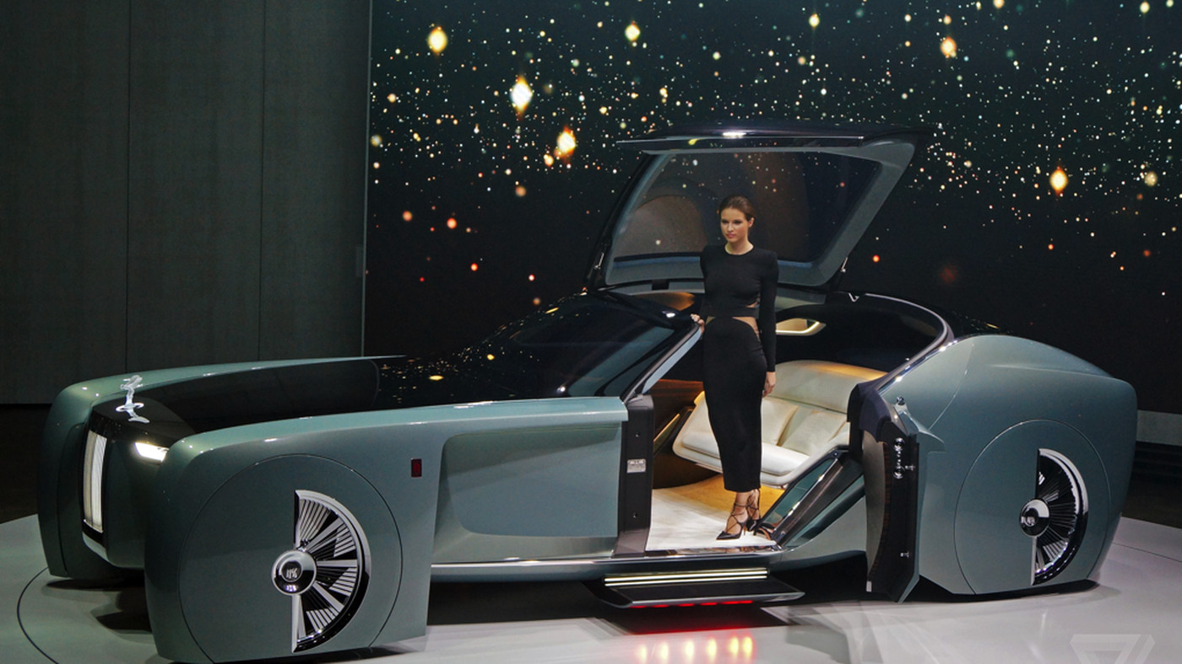
Introduction
If we had this progress and improvement in cars industries:
A Rolls Royce would cost 1 dollar and get a billion miles per gallon.
Notes:
Suggestion: Add slide after 11 that talks about how it is challenging to pull all of these powerful computers and networks together → this is what a distributed system is. Define distributed system, then move to cloud as an example of a type of distributed system. Add a definition of the cloud.

Slide 11
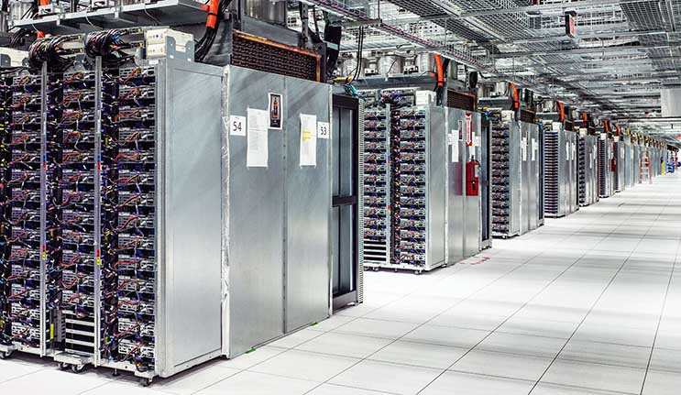
What is the Cloud?

Slide 12
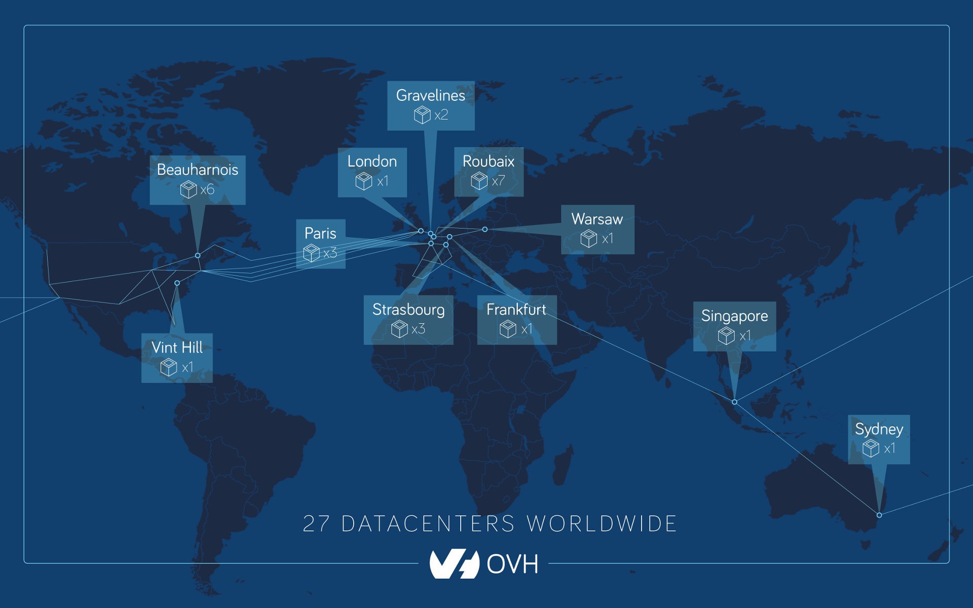
What is the Cloud
Giant warehouses
10s of thousands of servers
Petabytes of storage
10s of thousands of Processor cores
….Interconnected….

Slide 13
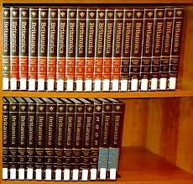

Why Infrastructure?
Why do we need this amount of infrastructures?
Encyclopedia Britannica
- 40,000+ articles
- 32 hard bound volumes (32,640 pages)
Wikipedia
- 5,512,202 articles (in English)
- More than 5 TB of text (about 7,500 CDs)
-More than 2000 volumes

Slide 14


And then BIG Data
Why do we need this amount of infrastructures?
Airbus A350
Contains around 6000 sensors across the entire plane that generates 2.5TB Data per day
Airbus A380-100
Expected to take the skies in 2020
Contains 10000 sensors just in each wings
Facebook
20 TB photos each week
Google
20000TB Data processing per day in 2008

Slide 15
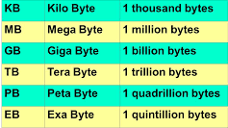
And then BIG Data
Google Search Statistics
The average figure of how many people use Google a day, which translates into at least 2 trillion searches per year, 3.8 million searches per minute, 228 million searches per hour, and 5.6 billion searches per day.
How much data do we generate?
According to the Forbes statistics:
2.5 quintillion bytes of data created each day
Over the last two years alone 90 percent of the data in the world was generated.

Slide 16
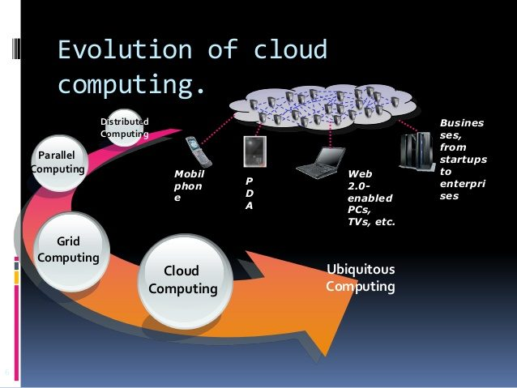
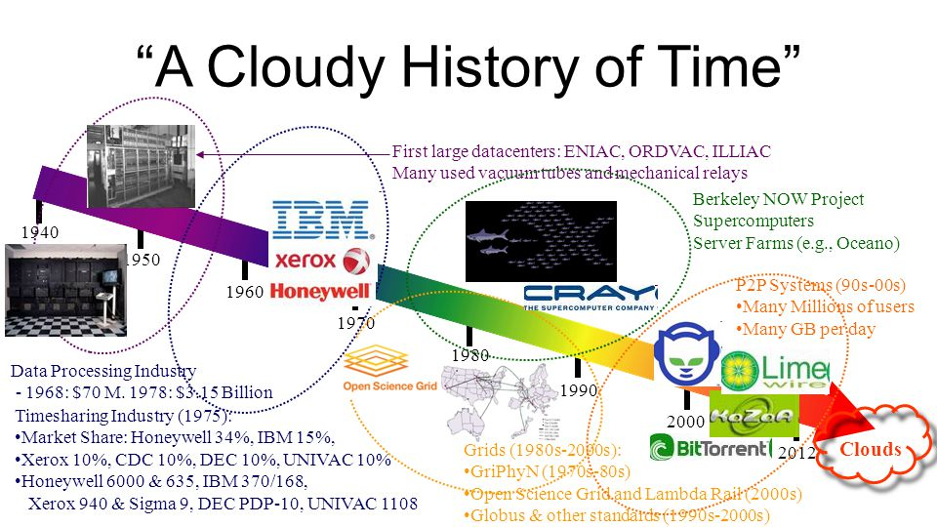
History of Cloud Computing
Notes:
Somewhere around here (before or after) precisely define cloud computing (something about a distributed system shared by many users, often at "global" scale)

Slide 17
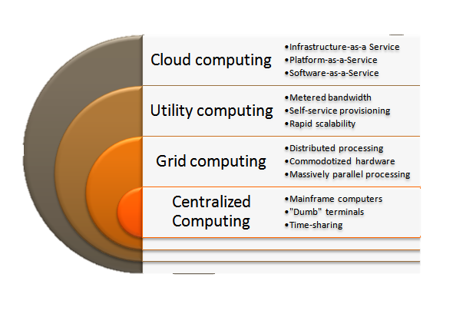
History of Cloud Computing
Notes:
Say that we will discuss more of these in a future lecture so students know they don't have to understand these terms yet

Slide 18
What’s New
There are four new features in the new generation of distributed and cloud systems:
Massive Scale
On-Demand Access: Pay-as-you-go
Data Intensive Nature: MBs became PBs and XBs
New Cloud Programming Paradigms: Map/Reduce Hadoop, Unstructured Data

Slide 19
*aaS Classification
HaaS : Hardware as a Service
Hardware and backbone
IaaS: Infrastructure as a Service
AWS, Azure, GCP
Paas: Platform as a Service
Google App engine, AWS Elastic Beanstalk
SaaS: Software as a Service
Google Doc, Dropbox

Slide 20
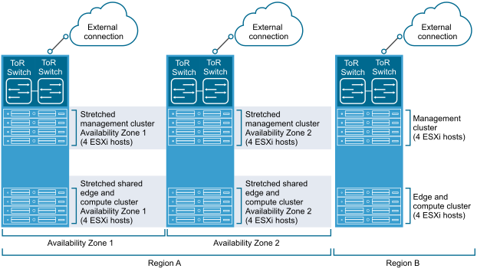
Cloud is a …
Cloud vs Distributed System vs Cluster
Client Server Architecture

Slide 21
Cloud is a …
Can we say “ Cloud is a fancy word for a Distributed System?”

Slide 22
What is a Distributed System
A distributed system is a collection of independent computers that appears to its users as a single coherent system. [Andrew Tanenbaum]
distributed system consists of components that are autonomous
users (be they people or programs) think they are dealing with a single system. (Transparency)
distributed systems should also be relatively easy to expand or scale.
Heterogeneity
Concurrency
Notes:
I suggest moving this definition much earlier in the talk. But then after introducing cloud, come back to this to talk about the gaols of DS and how they relate to cloud as an example

Slide 23
Goals of DS
Making resources accessible
Distribution Transparency
Access
Location
Migration
Relocation
Replication
Concurrency
Failure
Openness
Scalability

Slide 24
Accessibility
The main goal of a distributed system is to make it easy for the users and applications to access remote resources and to share them in a controlled and efficient way

Slide 25
Transparency
Transparency in simple words is defined as the concealment from the user and the application programmer of the separation of components in a distributed system, so that the system is perceived as a whole rather than as a collection of independent components.

Slide 26
Openness
An open distributed system is a system that offers services according to standard rules that describe the syntax and semantics of those services.

Slide 27
Scalability
Scalability means you can increase or reduce the capacity, power or abilities of your system. It can be measured along at least three different dimensions:
A system can be scalable with respect to its size (add more users/resources to the system – can be consider as Scale up)
A geographically scalable system is one in which the users may lie far apart (Scale out)
A system can be administratively scalable. It means that it can still be easy to manage even if it spans many independent administrative organizations.

Slide 28
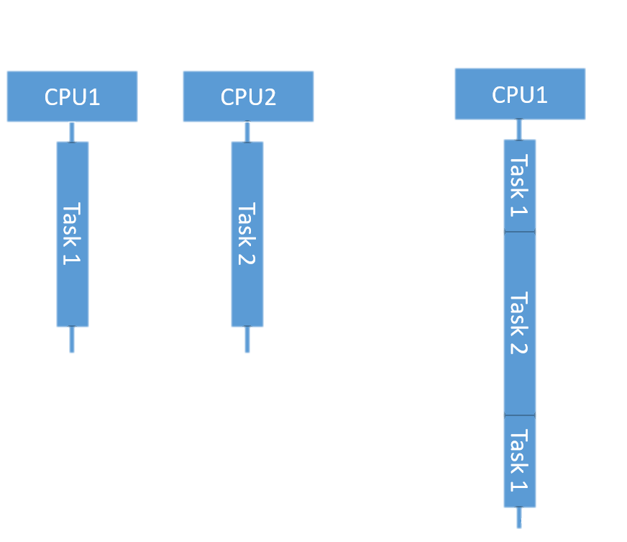
Concurrency vs Parallelism
Parallel
Concurrent
Concurrency considers the checkpoints
Parallelism considers time of progresses

Slide 29
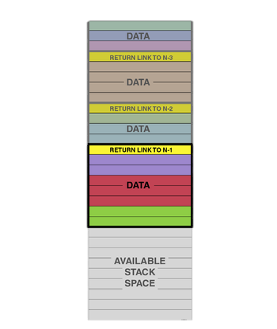
Process
Main()
F1()
Process
Stack
Program Counter
Heap
Etc.
F2()
Notes:
Potentially this slide could be removed / merged with the next one

Slide 30
Distributed ….
Distributed System = Many Processes ?????
P1
P2
P3
P4
…….. Pn
Reliable or Unreliable Communication

Slide 31
How can we Handle?
Faster Computer Or Add Another Computer?
Computer1
Computer2
Computer2
Computer2
Computer2
P1
P2
P3
P4
Distributed System Layer

Slide 32
Breakout
Grouping
~5 people each
Introduce yourselves:
Who are you? What do you want to learn from this course?
Answer these questions as a group:
What is something you learned from the lecture so far?
What is a part of the lecture was confusing to you?
Back to normal lecture in ~6 minutes!

Slide 33
HW 1: Go Parallel Sum

Slide 34
Parallel Sum
Assignment Goals:
Learn the basics of the Go programming language
Familiarize yourself with the editing environment and Git
Build two types of distributed systems
This is an individual assignment
You must write all your own code
You may discuss general ideas with other students and link them help documentation
You may give general advice for debugging and design, but you should never have your code open while looking at someone else’s code!
This is more lenient than many classes, don’t abuse it!

Slide 35
Why Go?
Go has become a very popular language for building distributed systems
Born at Google by Robert Griesemer, Rob Pike and Ken Thompson (C/Unix)
Power and performance of C, but with the convenience and safety of more modern languages
Learn more: https://golang.org/doc/faq
“Go … [attempted] to combine the ease of programming of an interpreted, dynamically typed language with the efficiency and safety of a statically typed, compiled language. It also aimed to be modern, with support for networked and multicore computing.”

Slide 36
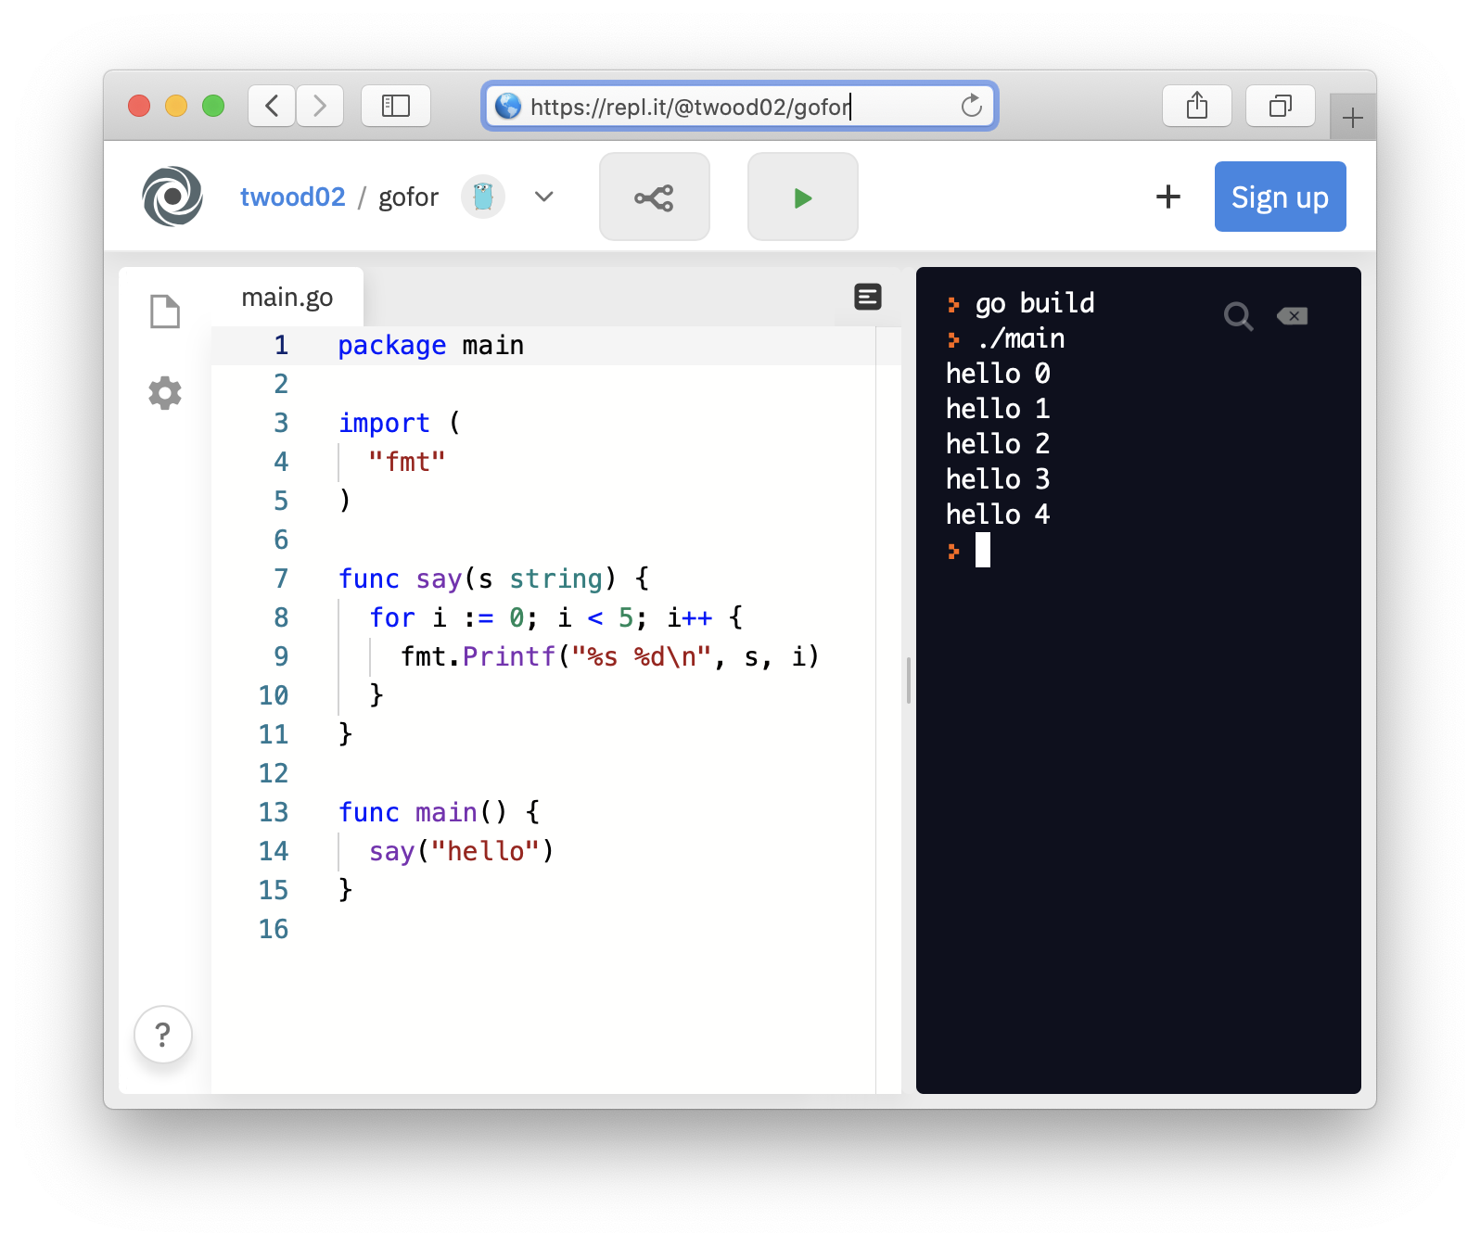
Phase 1: Sequential Sum
Starter code:
Reads a file and puts numbers in an array
Your code:
Use a for loop and add up the numbers
Add command line parameter support
(this should be easy even if you’ve never touched go)
Hint: Take a tour of Go
https://tour.golang.org/list
https://repl.it/@twood02/gofor

Slide 37
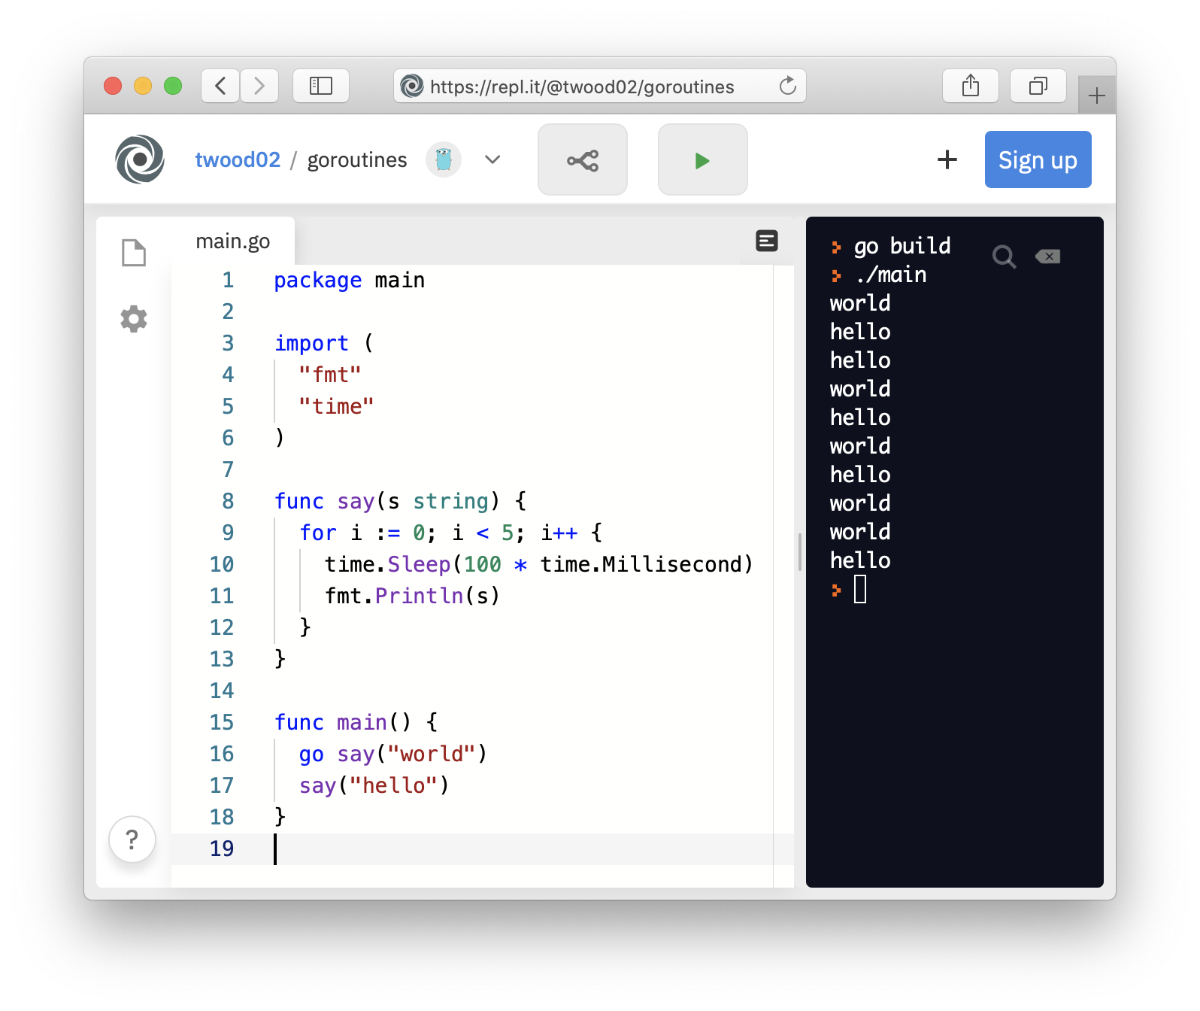
Phase 2: Parallel Sum
Main thread still reads in file and makes array (see starter code)
Use Goroutines to parallelize the addition
A Goroutine is a lightweight thread
What does this mean with regards to concurrency and parallelism?
How will the main thread and goroutines coordinate?
Need to pass numbers to be summed
Need to get back the result
Hint: learn about Go Channels!
https://repl.it/@twood02/goroutines

Slide 38
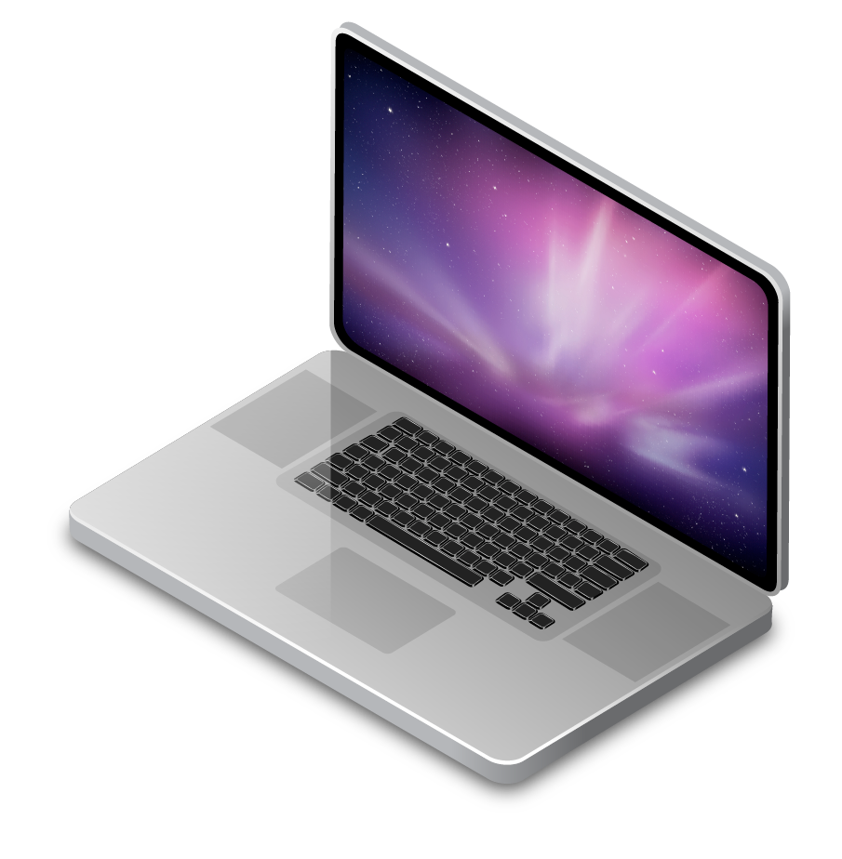
Phase 3: HTTP+RPC
Let’s make a “real” distributed system! Two Go programs:
HTTP Frontend
Accepts a client request specifying file to process
RPC Backend
Receives a Remote Procedure Call from frontend to trigger the summation
Uses goroutines to parallelize like in prior phase
HTTP Front
RPC Back
Client
Parallel sum

